Slide 1
Decision Trees
Gina Champion, Shyam Varanasi, Adam Duke

Slide 2
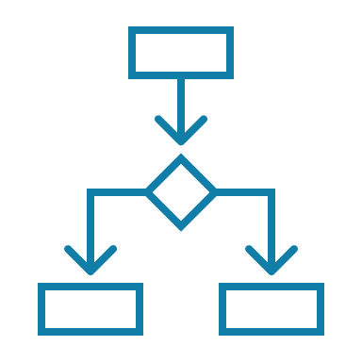



Overview of Decision Trees
Decision support mechanism (supervised learning algorithm)
One of the most popular machine learning algorithms
Can be used for both classification and regression purposes
Uses a tree like structure to solve a particular problem
Notes:
Decision trees are a decision support mechanism that model likelihood of a strategy reaching some state. A Decision Tree algorithm is one of the most popular machine learning algorithms. It uses a tree like structure and their possible combinations to solve a particular problem. It belongs to the class of supervised learning algorithms where it can be used for both classification and regression purposes. Nowadays, Decision Tree algorithm is known by its modern name CART which stands for Classification and Regression Trees.

Slide 3
Advantages of Decision Trees
Less data cleaning required, can accommodate missing data & outliers
Well suited to find interactions
Can handle both categorical & numerical variables
Easy to explain, interpret and use
Can be combined with other decision techniques and methods
Useful to make predictions
Require a relatively low degree of data preparation
Allow efficient learning of non-linear decisions
Notes:
Decision trees are one of the best forms of learning algorithms based on various learning methods. They boost predictive models with accuracy, ease in interpretation, and stability.
Primary advantage of decision trees are that they are easy to read, understand, interpret, explain & use as they follow a basic format, even if you don’t have a lot of statistical knowledge
Compared to other decision techniques, decision trees take less effort for data preparation.
Another advantage of decision trees is that, once the variables have been created, there is less data cleaning required. Cases of missing values and outliers have less significance on the decision tree’s data.
Decision trees are often used with other decision techniques & algorithms
They can easily handle both categorical & numerical data
Decision trees are used for handling non-linear data sets effectively
Tree models are well suited to finding interactions. If we split on one variable & then on another within the partitions of the first variable, we are finding an interaction between the 2 variables. As we construct further splits within splits, we are finding higher & higher order interactions
Decision trees are useful to make various predictions. For example, to predict if an email is SPAM or not, to predict health outcomes, to predict what group an individual belongs to based on a variety of factors that are specified in the decision tree model.

Slide 4
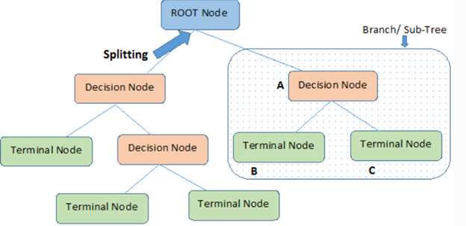
Composition & Key Terms
Notes:
A tree like structure composed of nodes, branches, and leafs.
In a Decision Tree algorithm, there is a tree like structure in which each internal node represents a test on an attribute, each branch represents the outcome of the test, and each leaf node represents a class label. The paths from the root node to leaf node represent classification rules.
Root Node: It represents the entire population or sample. This further gets divided into two or more homogeneous sets.
Decision Node: When a sub-node splits into further sub-nodes, then it is called a decision node.
Leaf/Terminal Node: Nodes that do not split are called Leaf or Terminal nodes.
Branch/Sub-Tree: A sub-section of an entire tree is called a branch or sub-tree.
Each node of the tree represents a rule whose result splits the options into several branches. As the tree is traversed downward a final leaf node is finally reached. This leaf node determines the class assigned to the data

Slide 5
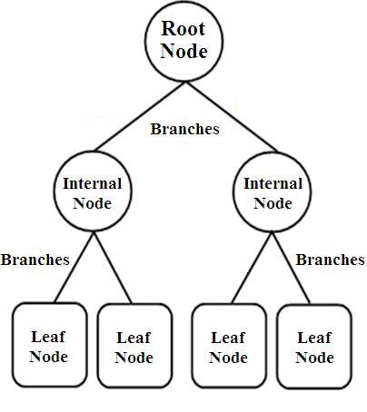
Recursive Partitioning Algorithm
For each attribute in the dataset, the algorithm forms a node
Start at the root node and work our way down the tree
Process continues until a leaf node is reached
Notes:
The Decision Tree algorithm intuition is as follows:
For each attribute in the dataset, the Decision-Tree algorithm forms a node. The most important attribute is placed at the root node.
For evaluating the task in hand, we start at the root node and we work our way down the tree by following the corresponding node that meets our condition or decision.
This process continues until a leaf node is reached. It contains the prediction or the outcome of the Decision Tree.
This is using the recursive partitioning regression algorithm, where we are minimizing the residual sum of squares

Slide 6
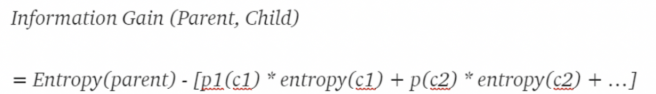
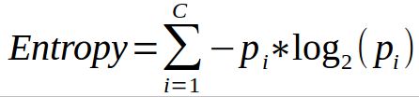
Splitting, Information Gain & Entropy
Splitting
Information Gain
Entropy
Process of dividing a node into 2 or more sub-nodes
How much information is gained as we go down the tree
Criteria to measure impurity of a node & determines randomness in a variable
Notes:
Splitting: process of dividing a node into 2 or more sub-nodes. Splitting of a node happens based on the Information Gain. Which features gives the highest information gain based on that splitting of nodes occurs.
Information gain is used to decide which feature to split on at each step in building the tree. At each step we should choose the split that results in the purest child nodes. Decision tree considers that every node contains information aims at maximizing Information Gain obtained after each split.
By using information gain as a criterion, we try to estimate the information contained by each attribute. To understand the concept of Information Gain, we need to know another concept called Entropy.
Decision Tree algorithm uses entropy to calculate information gain. The attribute with the highest information gain is chosen as the splitting attribute at the node.
Entropy measures the impurity in the given dataset. In Physics and Mathematics, entropy is referred to as the randomness or uncertainty of a random variable X. In information theory, it refers to the impurity in a group of examples. Information gain is the decrease in entropy. Information gain computes the difference between entropy before split and average entropy after split of the dataset based on given attribute values.
After every step entropy is calculated for every node. Entropy is used to check the purity of a node. The value of entropy ranges between [0,1]. Entropy = 1 means highly impure and Entropy = 0 means pure node. The optimum split is chosen by the feature with less entropy.
Looking at the formula for Entropy, c is the number of classes and pi is the probability associated with the ith class.

Slide 7
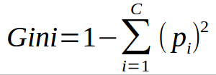
Gini Index
Another parameter used to calculate the impurity of a node
Computationally faster than Entropy
Range is [0,0.5] compared to [0,1] in Entropy
Notes:
Gini index is another parameter which is used in decision trees to calculate the impurity of a node. Its value ranges between [0, 0.5]. Gini index = 0 means pure node and Gini index = 0.5 means impure node. The attribute with minimum Gini index is chosen as the splitting attribute.
Gini is often considered better than entropy because it is computationally faster. Entropy uses logarithms, so it is a bit more complex.
Similar to the formula for Entropy, c is the number of classes and pi is the probability associated with the ith class.

Slide 8
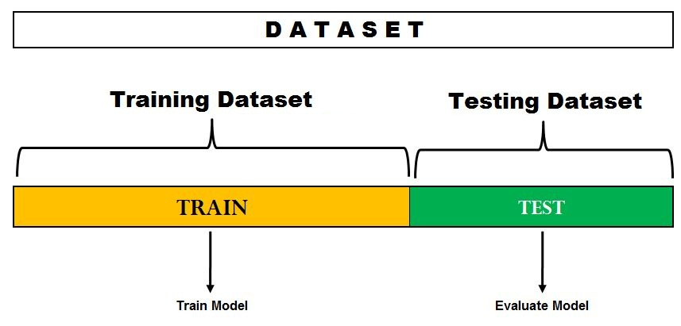
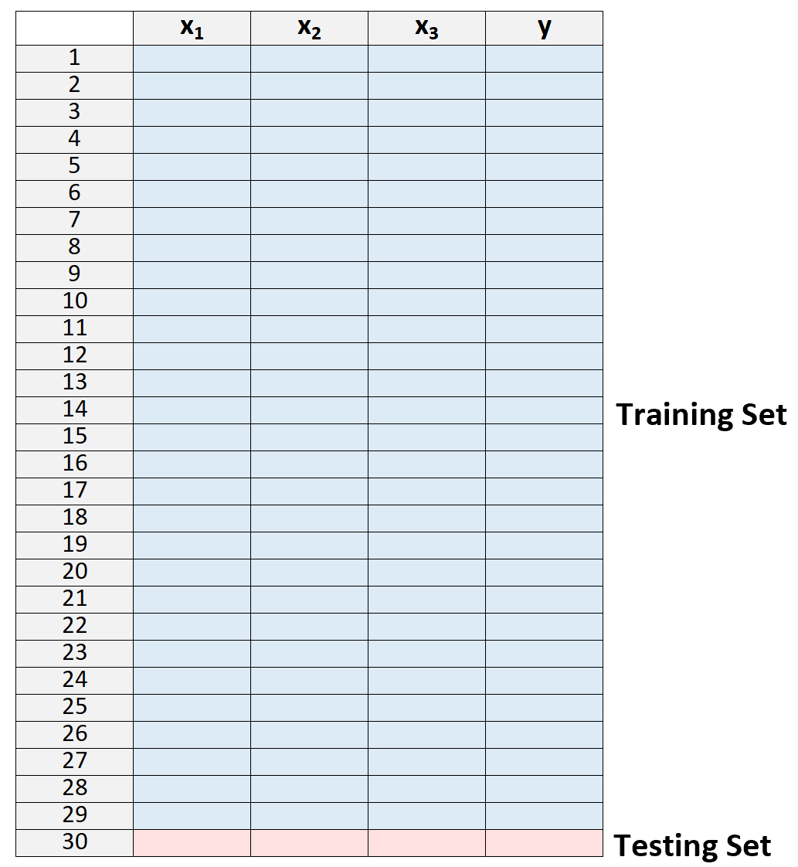
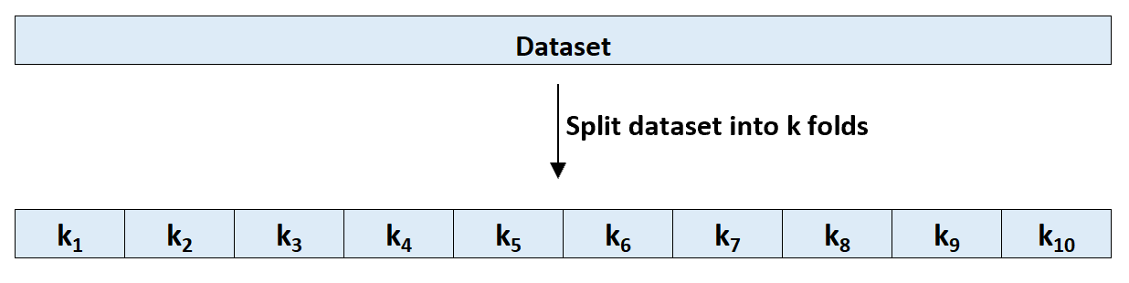
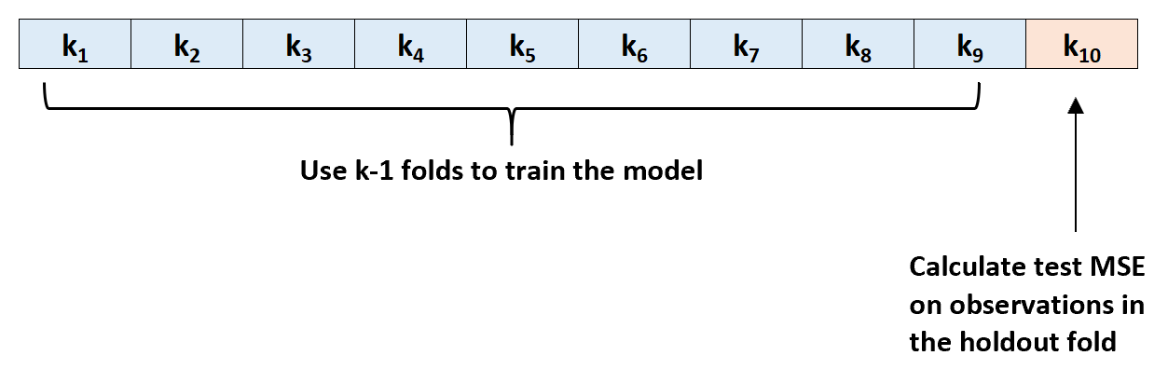
Cross Validation
Model evaluation method that is better than residuals
More realistic estimation of how the tree will perform in practice
Types of Cross Validation:
Hold out method
K-Fold
Leave one out
Hold Out Method
K-Fold
Notes:
Cross validation is a model evaluation method that is better than residuals. The problem with residual evaluations is that they do not give an indication of how well the learner will do when it is asked to make new predictions for data it has not already seen. CV is a more realistic estimate of how the tree will perform in practice
There are a few types of cross validation:
Hold-Out Method: involves randomly dividing the available set of observations into two parts, a training set and a validation set or hold-out set. The model is fit on the training set, and the fitted model is used to predict the responses for the observations in the validation set. The resulting validation set error rate—typically assessed using mean squared error—provides an estimate of the test error rate. The advantage of this method is that it is usually preferable to the residual method and takes no longer to compute. However, its evaluation can have a high variance. The evaluation may depend heavily on which data points end up in the training set and which end up in the test set, and thus the evaluation may be significantly different depending on how the division is made.
K-fold cross validation: The data set is divided into k subsets, and the holdout method is repeated k times. Each time, one of the k subsets is used as the test set and the other k-1 subsets are put together to form a training set. Then the average error across all k trials is computed. The advantage of this method is that it matters less how the data gets divided. Every data point gets to be in a test set exactly once, and gets to be in a training set k-1 times. Another example is that you can independently choose how large each test set is and how many trials you average over. The disadvantage of this method is that the training algorithm has to be rerun from scratch k times, which means it takes k times as much computation to make an evaluation.
Leave one out: special case of k-fold, With K = to N, the number of data points in the set. That means that N separate times, the function approximator is trained on all the data except for one point and a prediction is made for that point. Disadvantage of this is at first pass it seems very expensive to compute, since the model has to be fit n times. This can be very time consuming if n is large, and if each individual model is slow to fit.

Slide 9
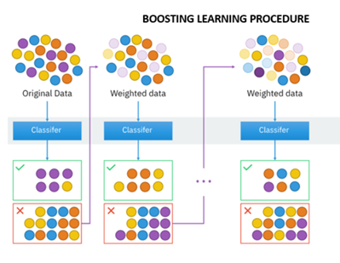
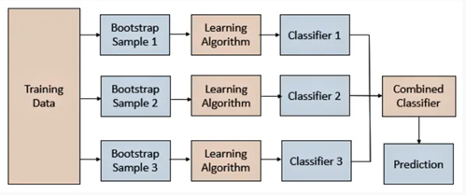
Bagging/Bootstrapping and Boosting
BAGGING: Bootstrapping & Aggregation
BOOSTING: Several models trained sequentially
Notes:
There are statistical techniques, such as bagging/bootstrap and boosting, that can be applied to reduce the variance of a decision tree.
Bagging is a type of bootstrap aggregation, which is a procedure used to reduce the variance of the model. Bagging is composed of two parts: Bootstrapping & aggregation.
Bootstrapping - Bootstrapping is a sampling method, where a sample is chosen out of a set, using the replacement method. The learning algorithm is then run on the samples selected. The bootstrapping technique uses sampling with replacements to make the selection procedure completely random. When a sample is selected without replacement, the subsequent selections of variables are always dependent on the previous selections, hence making the criteria non-random.
Aggregation - Model predictions undergo aggregation to combine them for the final prediction to consider all the outcomes possible. The aggregation can be done based on the total number of outcomes or on the probability of predictions derived from the bootstrapping of every model in the procedure. When using a decision tree for classification, it aggregates based off majority voting. For regressions, it aggregates through averaging.
The biggest advantage of bagging is that using multiple learning (training) samples can work better than a single strong one. It also provides stability & increases the accuracy of machine learning algorithms and can be used in both classification and regression. And, of course, it helps to reduce the variance and avoid overfitting.
Boosting refers to an ensemble method in which several models are trained sequentially with each model learning from the errors of its predecessors. Boosting means that each tree is dependent on prior trees. The algorithm learns by fitting the residual of the trees that preceded it. Thus, boosting in a decision tree ensemble tends to improve accuracy.

Slide 10
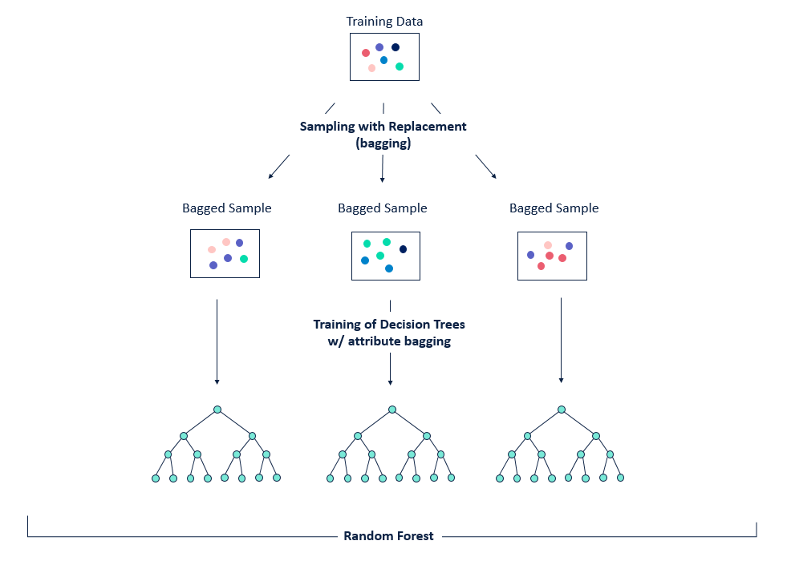

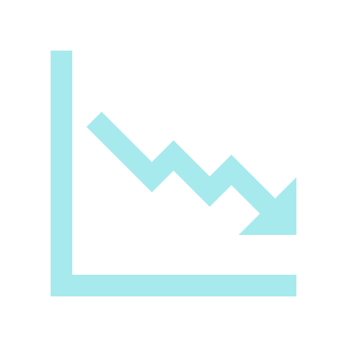


Random Forests
One of the most popular bagging algorithms
Variance & Bias Reduction
Able to work with a very large number of predictors
Strong Prediction Performance
Notes:
Random forests is one of the most popular bagging algorithms. It uses a combination of decision trees and introduces further randomization in the training of these trees. With random forests, you create random subsets of the features and build smaller trees based on each. Then, you combine these subtrees and average the results.
Why Random Forests Work:
Variance reduction: the trees are more independent because of the combination of bootstrap samples and random draws of predictors.
By working with a random sample of predictors at each possible split, the fitted values across trees are more independent. Consequently, the gains from averaging over a large number of trees (variance reduction) can be more dramatic.
Bias reduction: a very large number of predictors can be considered, and local feature predictors can play a role in tree construction.
Random forests are able to work with a very large number of predictors, even more, predictors than there are observations. An obvious gain with random forests is that more information may be brought to reduce bias of fitted values and estimated splits. Random forests have demonstrated strong prediction performance in practice across a wide range of datasets

Slide 11
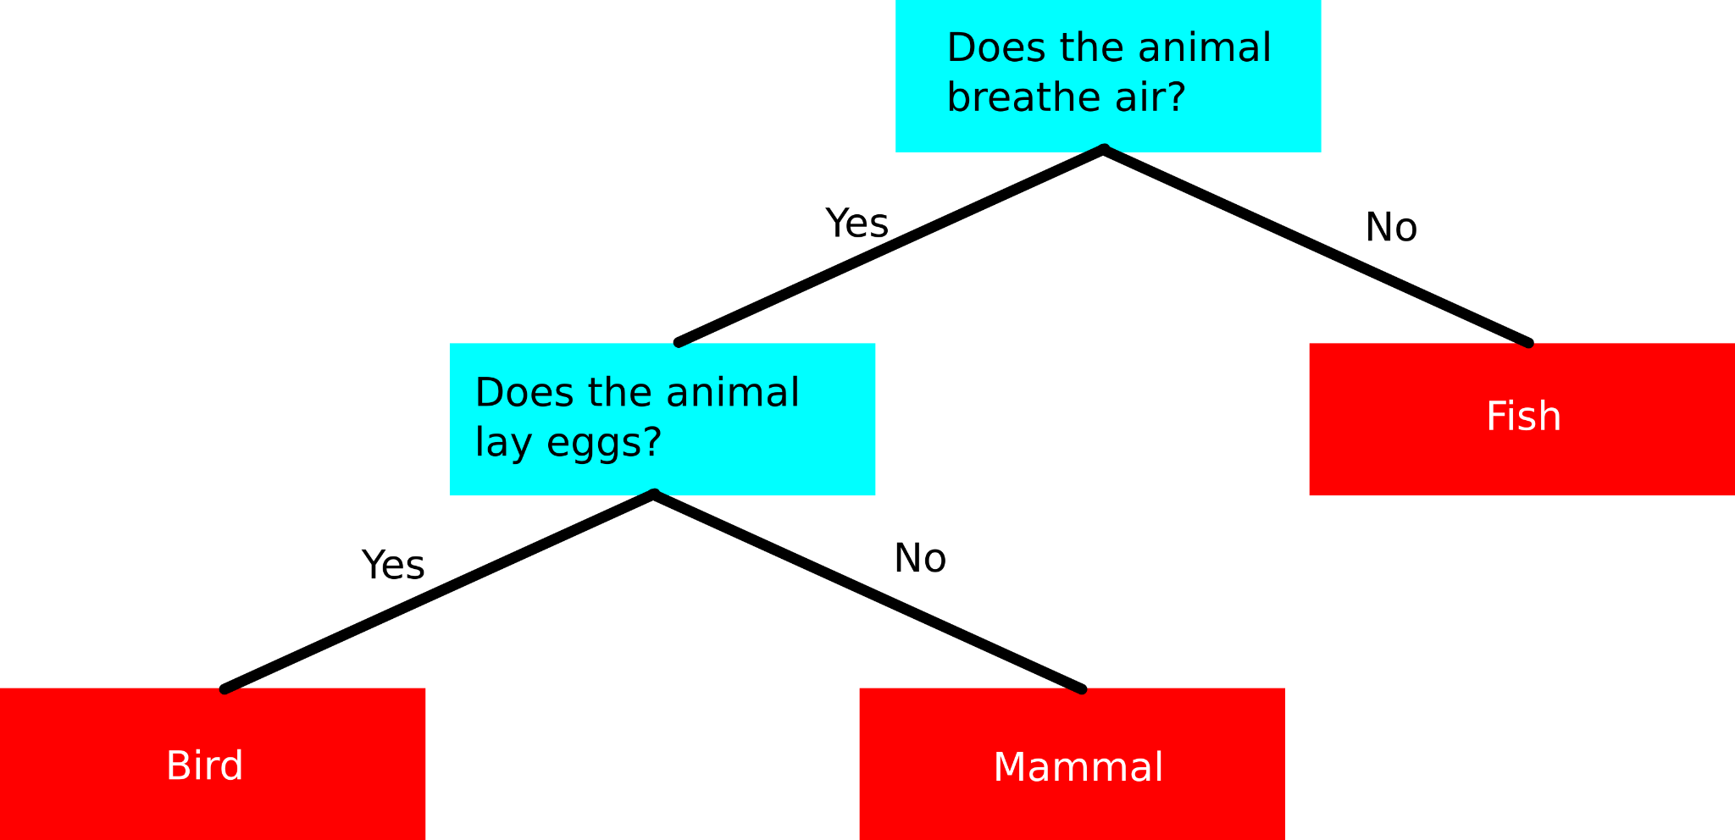
Classification Trees
Sequence of if-else questions about individual features
Objective:
infer class labels
Able to capture non-linear relationships
Doesn’t require feature scaling
Notes:
Data classification is a machine learning methodology that helps assign known class labels to unknown data. This methodology is a supervised learning technique that uses a training dataset labeled with known class labels. The classification method develops a classification model using a decision tree, by using information from the training data and a class purity algorithm. The resulting model can be used to assign a known class to new unknown data.
Classification trees involve a sequence of if-else questions about individual features. The objective is to infer class labels. Splits should divide observations within a node so that the class types within a split are mostly of one kind
Some advantages of classification trees are that they are able to capture non-linear relationships between features and labels and they don’t require feature scaling (ex: Standardization, ..)

Slide 12
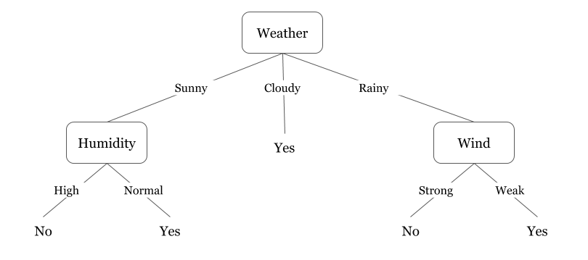
Example of Classification Trees in Practice
Classification Trees can be used in a wide variety of applications
Predicting whether or not a new mortgage prospect will default
Identifying whether or not to send a consumer a push-notification to complete a purchase
Can be used for multinomial classification as well
Which flavor of ice cream will sell at the highest volume each season

Slide 13
Coding Example: Classification
Situation
Factors
Response
Using Strokes-Gained data to predict whether or not a professional golfer will win on tour
Strokes Gained - Putting, Strokes Gained - Around the Green, Strokes Gained - Approach, and Strokes Gained - Off the Tee
Player wins a tournament (1) or doesn’t win a tournament (0)

Slide 14
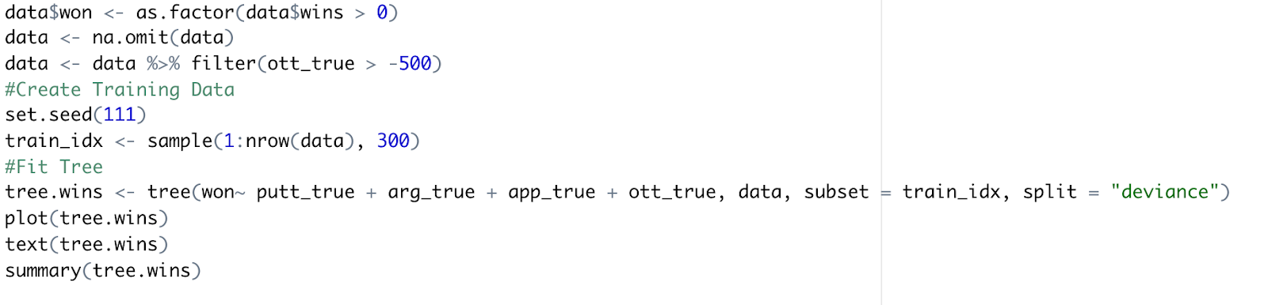
Coding Example - Classification
Using tree package for decision tree classification in R
Fit formula similar to glm() function

Slide 15
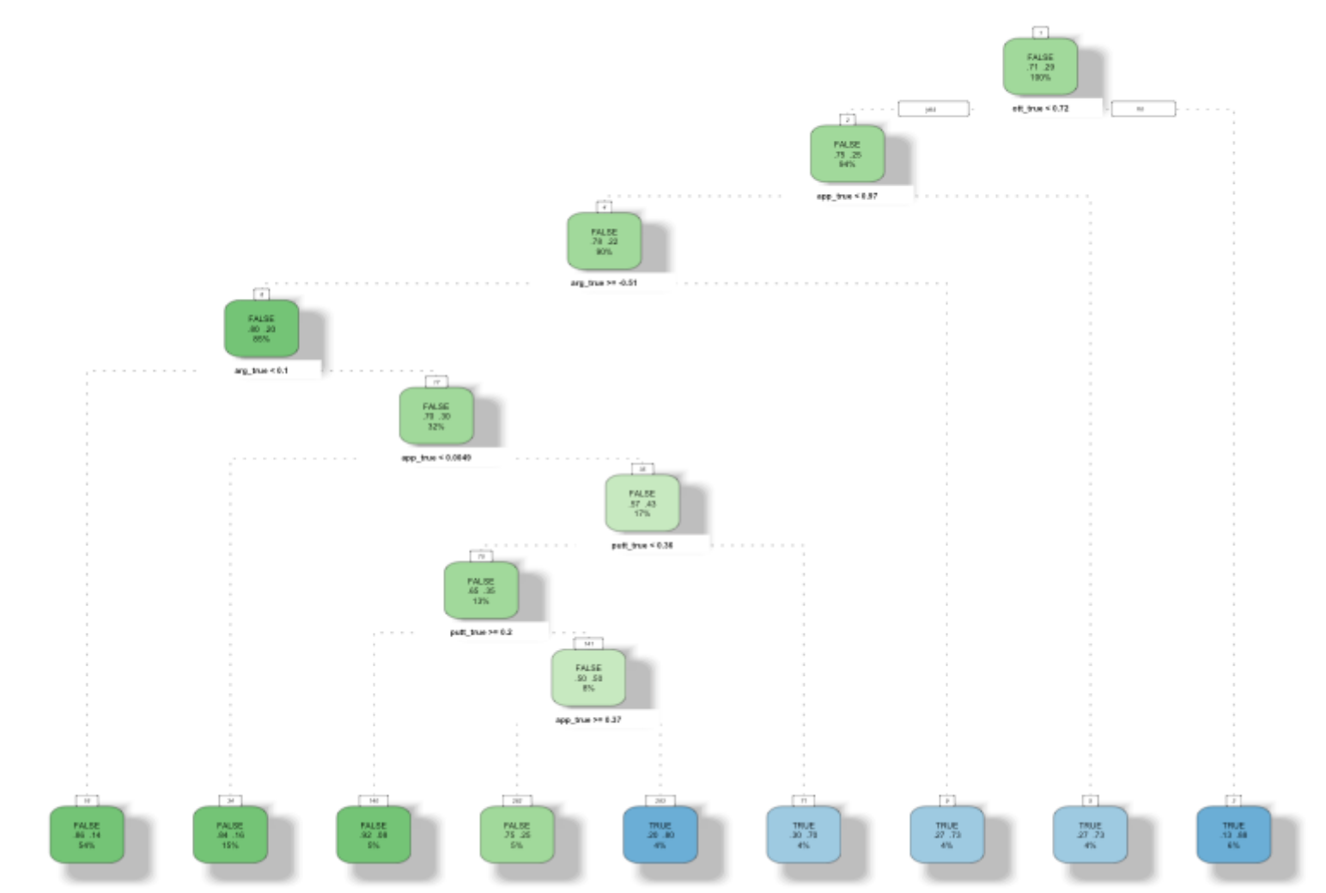
Coding Example - Classification
Tree output visualizes different decisions and criteria
Allows for easy interpretation on which factors “matter” and can easily be used to predict for an interactive experience

Slide 16
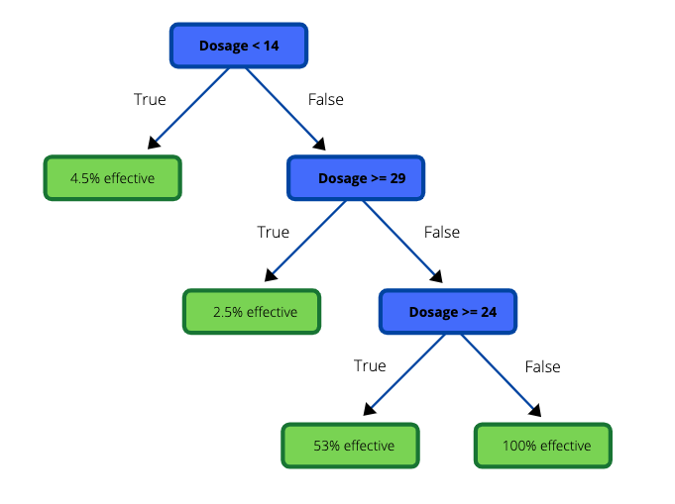
Regression Trees
Simpler to interpret than a linear regression
Two main purposes: Prediction & Explanation
Notes:
Regression trees are used when the target variable is continuous. They represent a compromise between the linear model & the completely nonparametric approach. Tree based methods share the transparency of linear models in that it is relatively easy to see how they work & understand how they will predict for new inputs. One of the primary advantages of a regression tree is that it is easier to interpret than a linear model. There are two main purposes for regression trees: prediction and Explanation.

Slide 17
Example of the Regression Tree in Practice
Predicting a baseball player’s salary based off hitting statistics
Predicting efficacy of drug based off dosage
Predicting the price of a car based on features

Slide 18
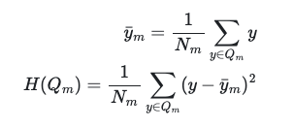
Coding Example: Regression
Boston Housing
13 Predictor Variables:
CRIM per capita crime rate by town
ZN proportion of residential land zoned for lots over 25,000 sq.ft.
INDUS proportion of non-retail business acres per town
CHAS Charles River dummy variable (= 1 if tract bounds river; 0 otherwise)
NOX nitric oxides concentration (parts per 10 million)
RM average number of rooms per dwelling
AGE proportion of owner-occupied units built prior to 1940
DIS weighted distances to five Boston employment centres
RAD index of accessibility to radial highways
TAX full-value property-tax rate per $10,000
PTRATIO pupil-teacher ratio by town
B 1000(Bk - 0.63)^2 where Bk is the proportion of black people by town
LSTAT % lower status of the population
Response Variable:
MEDV Median value of owner-occupied homes in $1000’s
Notes:
As we saw in the classification case, information gain is a function of entropy. When the target is a continuous variable, a different measure to minimize impurity in the data is used. Such measures may include mean squared error (MSE), mean absolute error (MAE), or half Poisson deviance (when the target is a count or a frequency).
We will use MSE in this example given:
Target: MEDV
[Jump to Jupyter Notebook]

Slide 19
Watchouts: Handling Missing Data
Missing values can be handled easily by tree methods
Make data discrete & divide into ranges, add missingness as an additional level
Allow tree algorithm to handle missing values naturally
Leave out entirely
Estimate missing values and then build the tree
Notes:
Missing values can be handled easily by tree methods. Simply exclude such point for the computation provided we weight appropriately
4 main options when you have missing values in your training set:
Build a tree model that discretizes the predictors into factors and treats missing values as another level. This would be appropriate if we think the missing values are informative in some way.
Fill in or estimate missing values, then build a tree. You can use methods to estimate the missing data similar to other regression problems. This is not always easy to implement and there are concerns about bias caused by these methods
Third, you can allow the algorithm to handle the missing values naturally. If a value is missing, it will simply be excluded from the criterion. We will follow the tree down until we reach a split that involves a missing value and then take a majority verdict in that node.
Last, we can leave the missing cases out entirely

Slide 20
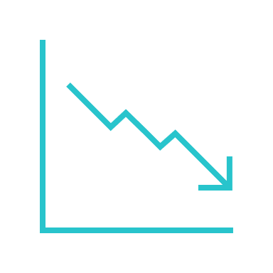

Watchouts: Overfitting
Overfitting Model = Accuracy of prediction goes down
Pruning: Remove sub-nodes of a decision node
Pre-Pruning:
Stop tree construction early
Prevents the tree from growing earlier, before training data is perfectly classified
Post-Pruning:
Build a complete tree
Most common approach
Notes:
Overfitting is a practical problem while building a Decision-Tree model. The problem of overfitting is considered when the algorithm continues to go deeper and deeper to reduce the training-set error but results with an increased test-set error. So, accuracy of prediction for our model goes down. It generally happens when we build many branches due to outliers and irregularities in data.
There are two approaches that can be used to avoid overfitting: Pre-Pruning & Post-Pruning.
Pruning: When we remove sub-nodes of a decision node, this process is called pruning. It is the opposite process of splitting.
In pre-pruning, we stop the tree construction a bit early. We prefer not to split a node if its goodness measure is below a threshold value. But it is difficult to choose an appropriate stopping point.
In post-pruning (also called post-trimming), we go deeper and deeper in the tree to build a complete tree. If the tree shows the overfitting problem then pruning is done as a post-pruning step. We use the cross-validation data to check the effect of our pruning. Using cross-validation data, we test whether expanding a node will result in improve or not. If it shows an improvement, then we can continue by expanding that node. But if it shows a reduction in accuracy then it should not be expanded. So, the node should be converted to a leaf node. Post-trimming is the most common approach because it’s often difficult to estimate when to stop growing the tree. The important thing is to define the criteria which determines the correct final tree size.

Slide 21
Limitations of Decision Trees
Unstable Nature: Sensitive to small changes in data
Potential for high variance if there is overfitting in the training set
Less effective in predicting outcome of continuous variables
Notes:
Some Limitations of CARTs include:
Unstable Nature: One of the limitations of decision trees is that they are largely unstable compared to other decision predictors. A small change in the data can result in a major change in the structure of the decision tree, which can convey a different result from what users will get in a normal event. The resulting change in the outcome can be managed by machine learning algorithms, such as boosting and bagging.
Potential for high variance if there is overfitting in the training set. If this is the case, use prunining methods mentioned earlier to reduce this.
Less effective in predicting the outcome of a continuous variable: In addition, decision trees are less effective in making predictions when the main goal is to predict the outcome of a continuous variable. This is because decision trees tend to lose information when categorizing variables into multiple categories.

Slide 22
Thank you!
ANY
QUESTIONS?

